Slide 1
Unit VI
Introduction to ARM processors
Advance RISC Machine
ARM company manufacture only core, not board
ARM is providing the CPU to many companies
https://www.youtube.com/watch?v=R8bH_pary3Y&t=7s
https://www.youtube.com/watch?v=KmF3YKwP18c&list=PLgwJf8NK-2e7nFEozQhZDZDSm09SwqbGP&index=5

Slide 2
Embedded system software and hardware
An embedded system is a combination of computer hardware and software designed for a specific function. Embedded systems may also function within a larger system. The systems can be programmable or have a fixed functionality. Industrial machines, consumer electronics, agricultural and processing industry devices, automobiles, medical equipment, cameras, digital watches, household appliances, airplanes, vending machines and toys, as well as mobile devices, are possible locations for an embedded system.

Slide 3
ARM
ARM processors are ideal for light, portable, battery-powered devices, such as smartphones, laptops and tablet computers, and other embedded systems, because of their low costs, little power consumption, and reduced heat generation than their competitors.
Devices like digital cameras, mobile phones, home network modules and wireless communication technologies use these processors, as well as a variety of embedded systems, such as Access Control, Communication Gateway, Medical System, and more.

Slide 4
Advances in ARM Processor Technology
25 fundamental instruction types are available in this CPU
Most activities are carried out by using registers
Each instruction has its own set of register conditions
There are numerous ways to address this processor
The stacks are manually manipulated
Specific approaches are used to address the stack and call subroutines in programmes
Because of the 32-bit microprocessor, data stored in those 32 bits can be accessed and manipulated
There is a 26-bit address range on this CPU
64 megabytes of memory are available to use for direct access
Single-cycle execution is the only method employed here

Slide 5
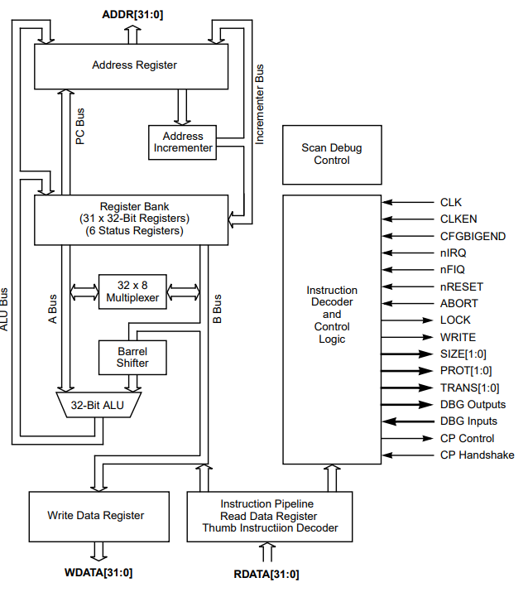
ARM7 TDMI interface signals
The ARM7TDMI-S architecture is a member of the Advanced RISC Machines (ARM) family of general-purpose 32-bit microprocessors, which offer high performance for very low power consumption and price.

Slide 6
ARM memory interface
The ARM7TDMI-S memory interface allows performance potential to be realized while minimizing the use of memory. Speed-critical control signals are pipelined to allow system control functions to be implemented in standard low-power logic. These control signals facilitate the exploitation of the fast burst access modes supported by many on-chip and off-chip memory technologies.
The ARM7TDMI-S has four basic types of memory cycles:
♦ idle cycles
♦ nonsequential cycles
♦ sequential cycles
♦ coprocessor register transfer cycles

Slide 7
ARM register set
The Thumb state register set is a subset of the ARM state set. The programmer has direct access to:
• eight general registers, R0-R7
• the Program Counter (PC),
• a stack pointer register (SP),
• a link register (LR),
• and the Current Program Status register (CPSR).
There are banked Stack Pointers, Link registers and Saved Process Status registers (SPSRs) for each privileged mode

Slide 8
low-power microprocessor design for IoT devices
https://www.youtube.com/watch?v=8QZ3UbGpbgo
Introduction to edge computing and Microprocessor requirements for edge devices
https://www.youtube.com/watch?v=5aepM3ek6J0

